Slide 1
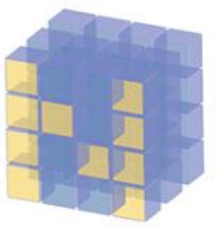
Dataset Noisy_Bowl

Slide 2
Reference
Youtube on np.meshgrid
Youtube on 3D plot
Youtube
Code

Slide 3
Load Noisy_Bowl

Slide 4
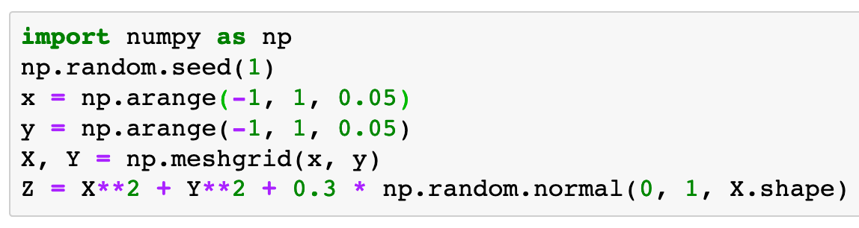

Slide 5
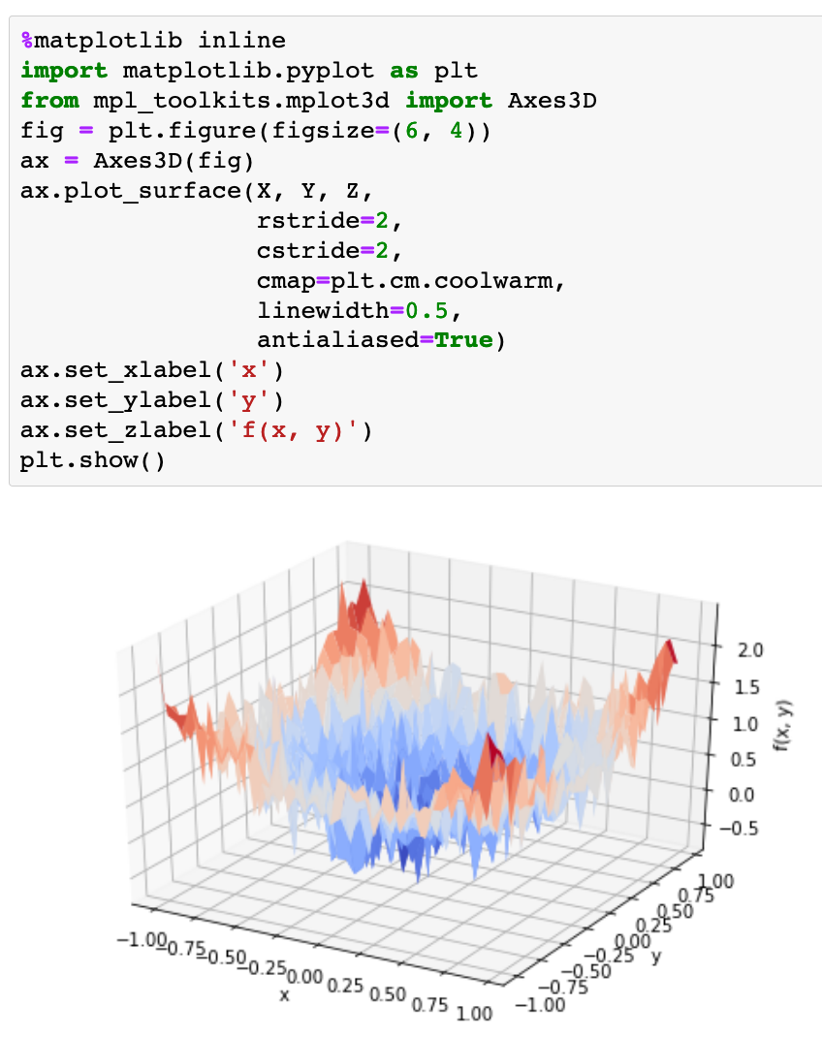

Slide 6
Load Noisy_Bowl Functional Form

Slide 7
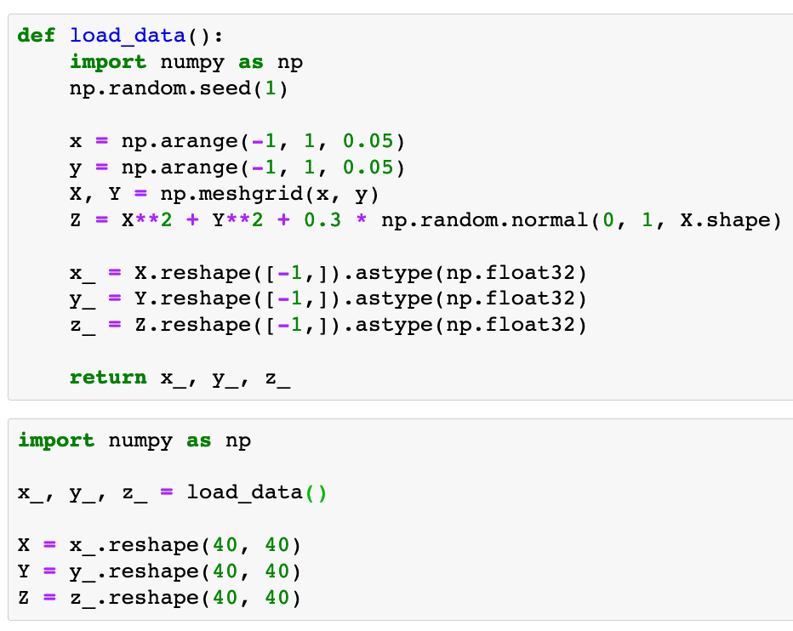


Slide 10
Load Clean_Bowl Functional Form

Slide 11
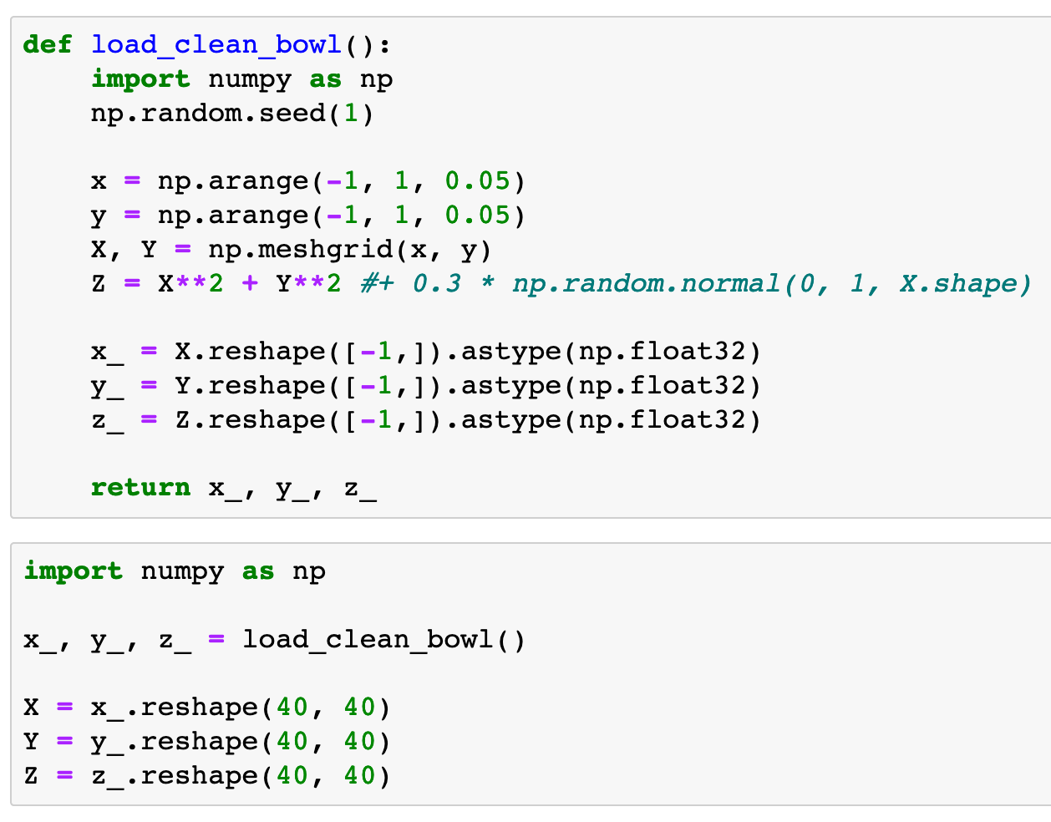

Slide 13
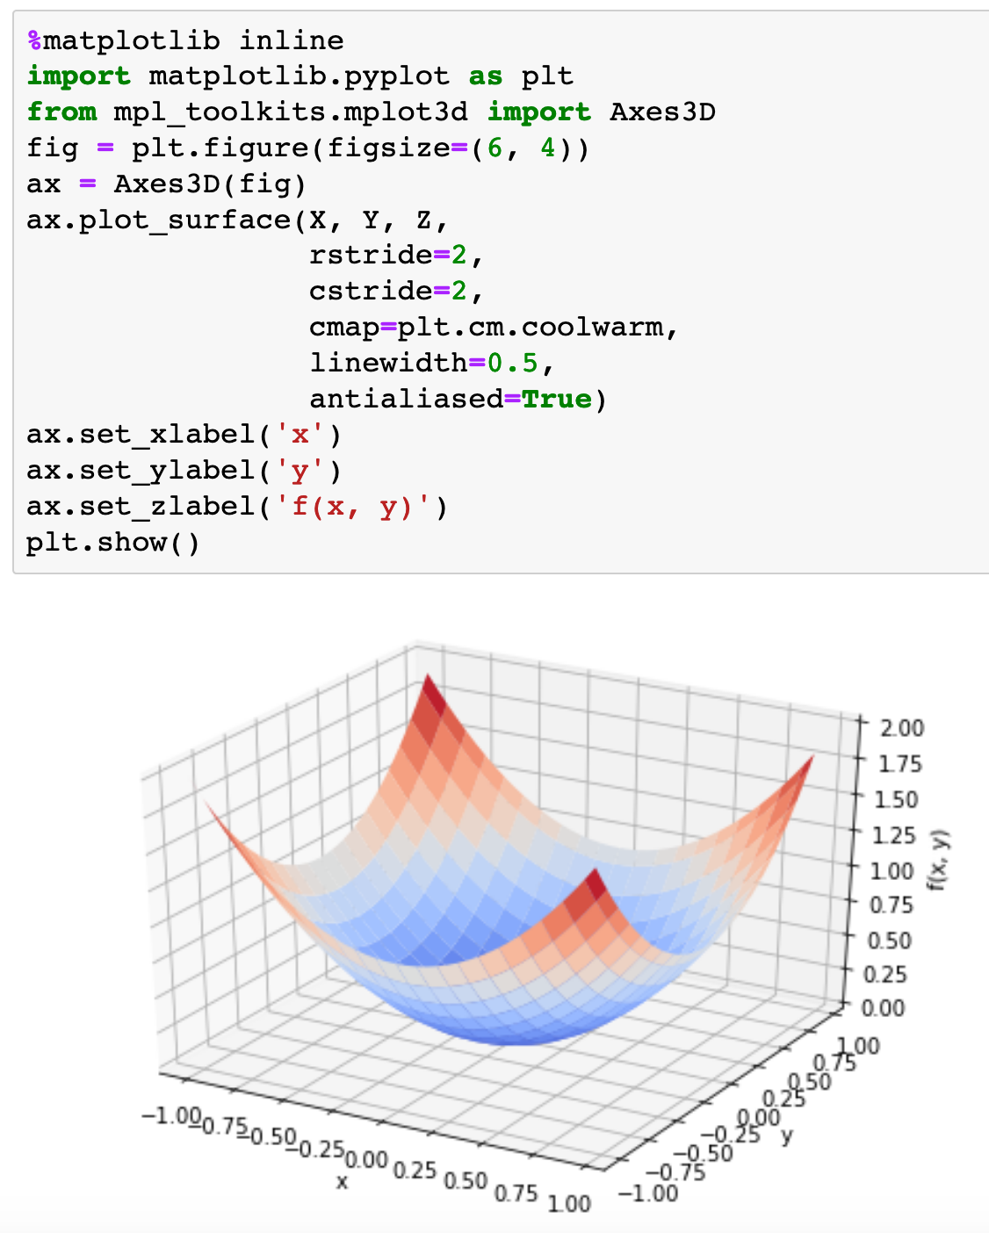

Slide 14
Now
Let’s Play with Code

